Slide 1

FPGA In Reliability and Safety Critical Applications
Neaz Mahmud

Slide 2
Agenda
Safety Critical System
01
Why In Reliability and Safety Critical Field?
02
Standards
03
Fault Models
04
Solutions
05

Slide 3
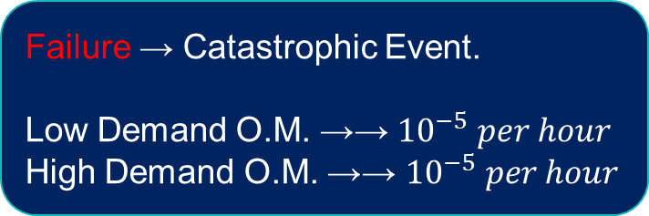
What ,Where and How?
Aerospace, Nuclear power & Transportation
Failure → Catastrophic Event.
Low Demand O.M. →→ ${10}^{−5} per hour$
High Demand O.M. →→ ${10}^{−5} per hour$
*Detection & Correction
*Redundant Components, Error-Detection and Correction Algorithms & Fail-safe Mechanisms
*Rigorous Testing and Validation

Slide 4
Why FPGA But Not ASIC?
Flexibility
Redundancy
Energy Efficiency
Performance

Slide 5

Standards
IEC 61508-2 and IEC 61508-3 → Equipment & Software systems.
ECSS-Q-ST60-02C & RTCA/DO-254 → Aerospace
ISO/DIS 26262-5 & ISO/DIS 26262-6 → Automotive Field
CENELEC EN 50128 & CENELEC EN 50129 → Railway
IEC 61508-2 → FPGA Development

Slide 6
Fault Models
Random
Systematic
Unpredictable
At different stages such as (Manufacturing, Testing, Operation or aging)
Specific Cause/Conditions, Predictable & Consistent

Slide 7
Random Faults
Single Event Upsets (SEUs)
Clock Jitter
Voltage Drops
Temperature Variations
Interconnect Failure

Slide 8
Systematic Faults
Manufacturing defects
Power supply issues
Timing issues
Input/Output

Slide 9

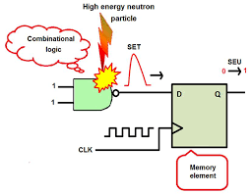

Single Event Upset (SEU)
Change in the state of a memory cell .
High-energy particle(cosmic ray).
Bit flip, (0 to 1 or 1 to 0)
Radiation Hardening
Error Detection &
Correction (EDAC)
Fault-tolerance design
https://scholars.unh.edu/cgi/viewcontent.cgi?article=1983&context=thesis

Slide 10
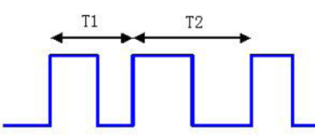

Clock Jitter
External Noise
Power Supply Fluctuations
Temperature changes.
Errors in Data Transmission
Timing of Digital Signals
System Malfunction.
PLL (Phase Locked Loop)
Clock distribution
Synchronization

Slide 11
Voltage Drops
Power Supply Noise
Electromagnetic Interference (EMI)
Voltage Fluctuations
High Operating Temperatures
High Current Demands.
Voltage Over-Regulation
Voltage Drop Compensation
Power Supply Decoupling

Slide 12
Temperature Variation
External Temperature Changes
High Power Dissipation
Poor Thermal Management
Thermal Management
Temperature-Aware Design
Temperature-Compensated Clock Generation.

Slide 13
Interconnect Failure
Manufacturing Defects
Wear & Tear
Exposure to Environmental Factors
3D IC
Advanced Packaging
Embedded Processors

Slide 14
Manufacturing Defects
Quality Control
Advanced packaging and 3D technologies
Design for Manufacturability (DFM) Analysis
Process improvement
Failure Analysis
Open or shorted interconnects
Defective logic gates
Metal layer defects
Photolithography defects

Slide 15
Power Supply Issue
Stable power supply
Power Distribution Network Design:
Power-up Sequencing
Over & Under voltage Protection
Electrostatic Discharge(ESD) protection
Overvoltage
Undervoltage
Power supply noise
Power supply sequencing

Slide 16
Timing Issue
Clock skew
Setup and hold time violations
propagation delay
Timing closure
Timing analysis
Logic Simulation
ATPG(Automatic Test Pattern Generation)

Slide 17
Input/Output Error
Open or shorted I/O pins
Incorrect I/O configuration
Protocol mismatch
Noise or interference on the I/O lines
Proper I/O interfaces
Stable power supply
Signal integrity
ESD protection

Slide 18
Conclusion
Only start designing a safety-critical FPGA-based system after a well-structured and well-documented design flow is identified
Never quite rely on the CAD tools of the FPGA device vendor and always check the intermediates of all phases of the design process using external tools
The designer must be familiar with all the technological details of the final destination device that will host the system.

Slide 19
THANK YOU

Slide 20
References
[1] Francisco Cardells-Tormo, Javier Valls-Coquillat, Vicenc Almenar-Terre, and Vicente Torres-Carot. Efficient fpga-based qpsk demodulation loops:
Application to the dvb standard. In International Conference on Field Programmable Logic and Applications. Springer, 2002.
[2] Antonino Mazzeo, Luigi Romano, Giacinto Paolo Saggese, and Nicola Mazzocca. Fpga-based implementation of a serial rsa processor. In
2003 Design, Automation and Test in Europe Conference and Exhibition. IEEE, 2003.
[3] Henrik Christopherson, Wayne Pickell, Adrian Koller, Suresh Kannan, and Eric Johnson. Small adaptive flight control systems for uavs using
fpga/dsp technology. In AIAA 3rd” Unmanned Unlimited” Technical Conference, Workshop and Exhibit, page 6556, 2004.
[4] Radek Dobias and Hana Kubatova. Fpga based design of the railway’s interlocking equipments. In Euromicro Symposium on Digital System
Design, 2004. DSD 2004., pages 467–473. IEEE, 2004.
[5] Jingke She and Jin Jiang. Application of fpga to shutdown system no. 1 in candu. In 6th American Nuclear Society International
Topical Meeting on NPIC&HMIT, April, Knoxville, Tennessee, USA, 2009.
[6] A Sutton. No room for error: Creating highly reliable, high-availability fpga designs, april 2012, 2014.
[7] International Electrotechnical Commission et al. Functional safety of electrical/electronic/programmable electronic safety-related systems-part 2, examples of methods for the determination of safety integrity levels. IEC 61508-5, 1998

